Slide 1
DECISION TREES AND RANDOM FORESTS

Slide 2
TODAY’S LEARNING OBJECTIVES
DECISION TREES AND RANDOM FORESTS
Understand and build decision tree models for classification and regression with the sklearn library
Understand and build random forest models for classification and regression
Know how to extract the most important predictors in a random forest model

Slide 3
OPENING
DECISION TREES AND RANDOM FORESTS

Slide 4
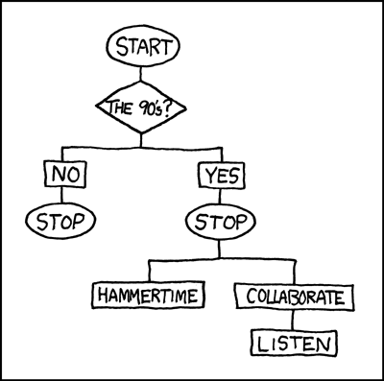
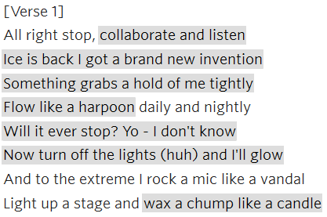
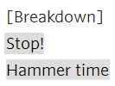
I LOVE (CLASSIFYING) THE 90s
Too Cold – Vanilla Ice (1998)
U Can’t Touch This – MC Hammer (1990)

Slide 5

WHERE ARE WE IN THE DATA SCIENCE WORKFLOW?
Data has been acquired and parsed.
Today we’ll refine the data and build models (We’ll also use plots to represent the results).

Slide 6
WHERE ARE WE IN THE MACHINE LEARNING UNIVERSE?

Slide 7
COMMON TREE ALGORITHMS

Slide 8
INTRODUCTION
DECISION TREES

Slide 9
DECISION TREES
Decision Trees are a machine learning model for regression and classification that develops a series of yes/no rules to explain the differences present in the outcome variable.

Slide 10
DECISION TREES
Decision trees use a machine learning algorithm which runs best in a supervised environment to recursively segment the data into subgroups that are as similar as possible with respect to the target.
Inputs | Continuous and categorical variables
Outputs | Regression Classification
Strength | Easily interpretable Handle nonlinear relationships
Weakness | Easy to over-fit without pruning Sensitive to data changes
Height of Plant
>1 ft
Leaf Size
<1 ft
<0.4 in²
Flowering
>0.4 in²
No
Yes
Based on height & leaf size – what kind of plant is this?
Do I have enough information to determine the type of plant?
Why is plant height more important than leaf size?

Slide 11
DECISION TREES
Fit
1
2
2 Red, 1 Blue
y
x
Is X > 0?
True
False
Prediction: BLUE
0 Red, 1 Blue
2 Red, 0 Blue
5
y
Predict
4
x
2 Red, 1 Blue
3
y
Is X > 0?
x
True
False
0 Red, 1 Blue
2 Red, 0 Blue

Slide 12
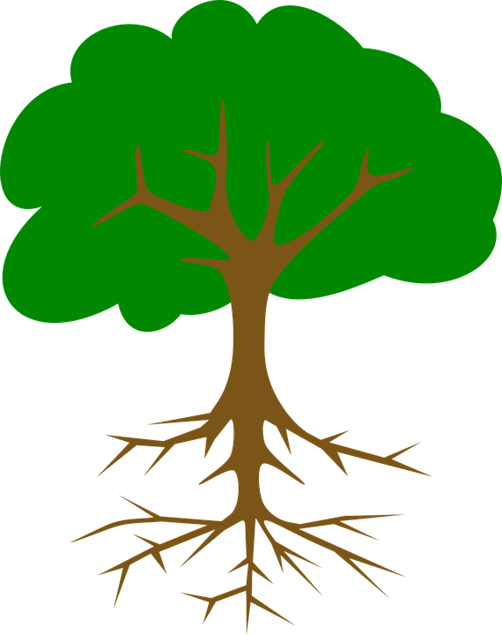


DECISION TREES
When displayed, these series of rules appear as a tree with several branching paths or splits.
The starting point of a decision tree is referred to as the root and subsequent branching points are called nodes. Nodes that do not split further are then called leaves.
Using our example decision tree:
2 Red, 1 Blue
Is X > 0?
True
False
0 Red, 1 Blue
2 Red, 0 Blue

Slide 13
DECISION TREES
The structure of a decision tree is determined by what yes/no rules will best predict the outcome variable.
This is measured at each point of a decision tree by the gini impurity which measures the homogeneity of the outcome variable in a dataset from 0 (uniform) to 1 (inconsistent).
Each rule in a decision tree decreases the gini impurity in the data until it approaches 0.
For regression trees, MSE (or mean squared error) is often used in place of gini impurity.

Slide 14
SIMPLE EXAMPLE
Dataset A
Dataset B
y
y
3
2
x
x
-3
-2
Dataset A – if Y < 0 & X > 0 then RED, else BLUE
Dataset B – if Y > 2 & X > -2 then BLUE, else RED
Notes:
Solutions:
Dataset A – if Y < 0 & X > 0 then RED, else BLUE
Dataset B – if Y > 2 & X > -2 then BLUE, else RED

Slide 15
DECISION TREE OUTPUT

Slide 16
INTRODUCTION
PROS AND CONS
OF DECISION TREES

Slide 17

PROS AND CONS OF DECISION TREES
Decision trees are non-linear (a change in a predictor variable has a constant change on the output variable) which gives them more flexibility over linear models (e.g. linear regression).
Decision trees also produce easily interpreted visuals from which variable importance can be derived.

Slide 18
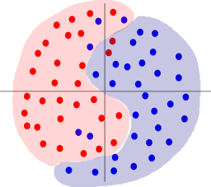
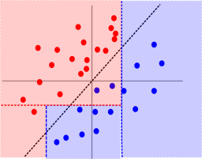
PROS AND CONS OF DECISION TREES
Decision trees are computationally intensive relative to other models, especially if you don’t prune them.
Decision trees are sometimes too flexible and can easily overfit your data. Cross-validation and tuning are key to keeping decision tree models generalizable.
Fit:
Predict:

Slide 19
K-Fold Cross Validation
Cross validation uses all the data to ensure that model measurements were not biased by a particularly lucky sample
Fold 1
Fold 2
Fold 3
Fold 4
Fold 5
Test
Train
Train
Train
Train
Train
Test
Train
Train
Train
Train
Train
Test
Train
Train
Train
Train
Train
Test
Train
Train
Train
Train
Train
Test
Test | Prediction Statistics
Test
Test
Test
Test
Complete Data
In 5-fold cross validation, one-fifth of the data is used for a testing set in each fold. Then the test set statistics are computed jointly to evaluate how well the model performed.
*Material adapted from “Conversational Analytics” course

Slide 20
INTRODUCTION
ENSEMBLE METHODS

Slide 21
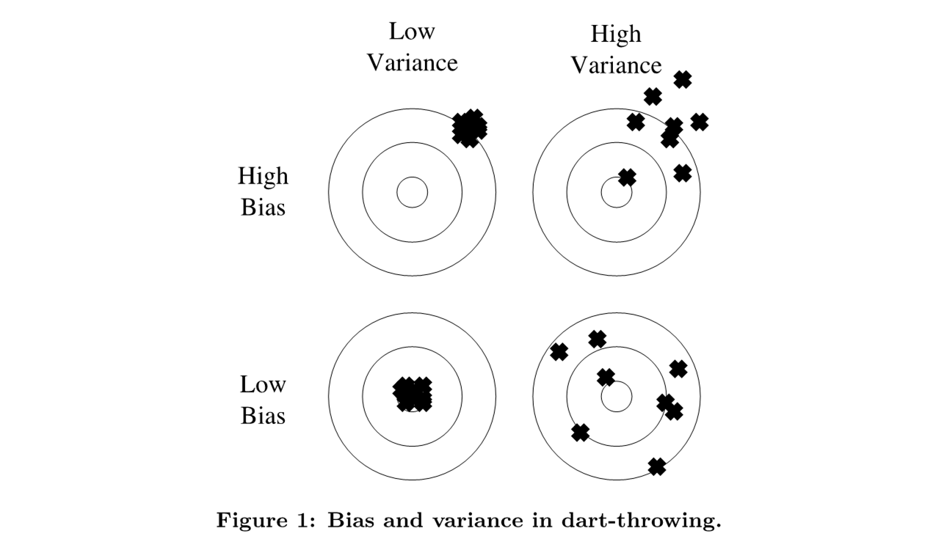
BIAS VS VARIANCE
Bias
Definition:
How close the model’s estimate is the to the true value (within our sample)
Variance
Supervised:isi
Definition:
How consistent is our predictor over all possible samples drawn from the target population

Slide 22
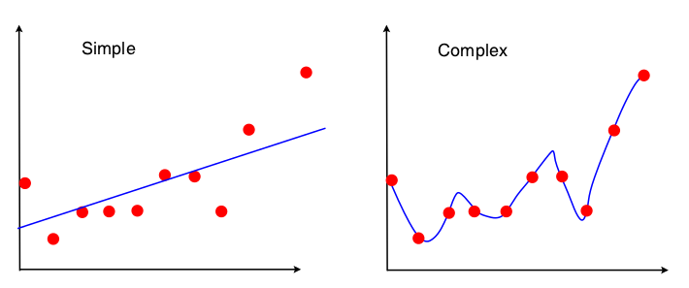
BIAS VS VARIANCE TRADE-OFF
Simple models (few parameters) have higher bias, but lower variance
Result: Underfitting
Complex models (many parameters) usually have lower bias, but higher variance.
Result: Overfitting

Slide 23
ENSEMBLE LEARNING
Definition:
Ensemble methods are learning algorithms that construct a set of classifiers and then classify new data points by taking a (weighted) vote of their predictions¹
Example:
Generate 100 different decision trees from the same or different training set and have them vote on the best classification for a new example
Key Motivation:
Reduce the error rate. The hope is that it will become much more unlikely that the ensemble of models will misclassify an example

Slide 24
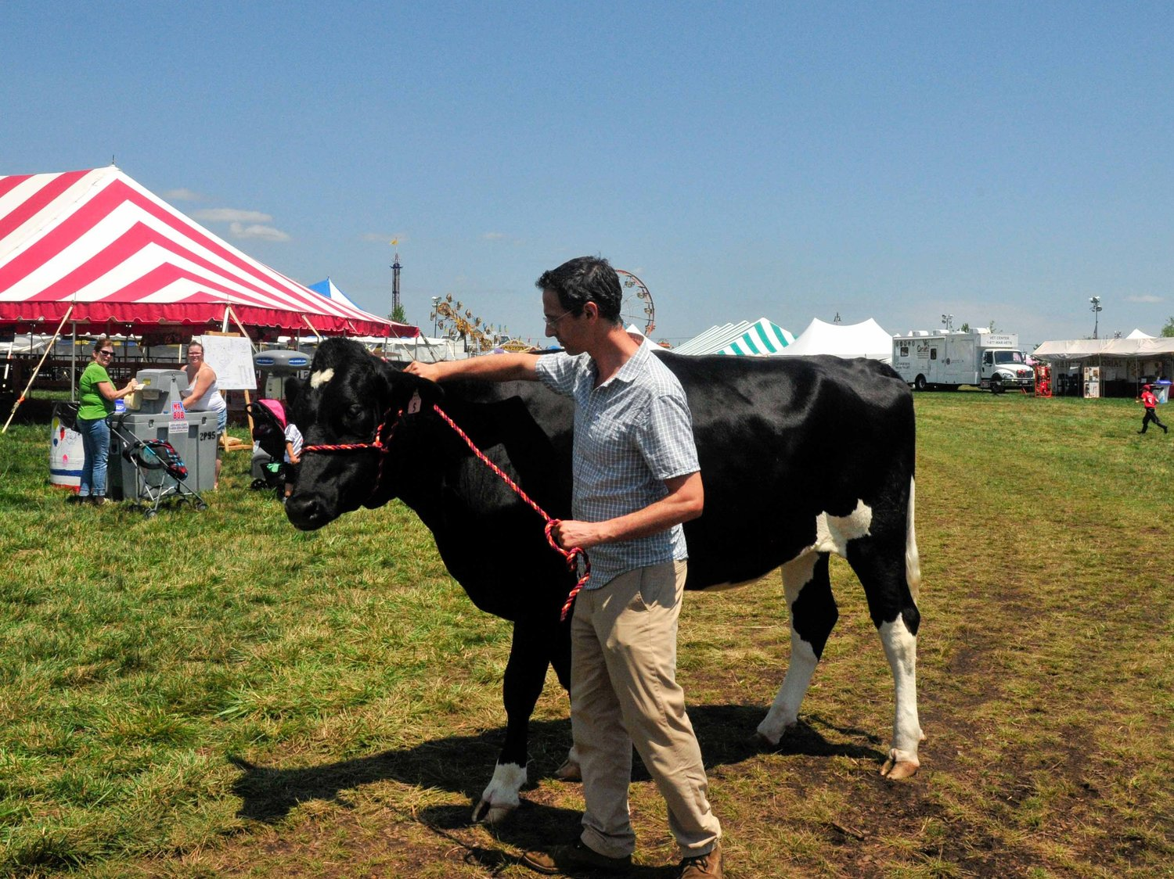
How much does this cow weigh?
ENSEMBLE LEARNING
Hypotheses
1200 | 1450 | 1300
900 | 2000 | 1100
1500 | 800 | 2100
1300 | 1200 | 1650
1800 | 1200 | 1500
1900 | 1000 | 1000
2000 | 750 | 600
1500 | 1250 | 1350
Average |  | 1348
Truth |  | 1355
“Wisdom of the Masses”
First used to explain political concepts
Theory flawed in practice, but general idea relates well to Ensemble Methods

Slide 25
ENSEMBLE METHODS
Learn multiple alternative definitions of a concept using different training data or different learning algorithms. Combine decisions of multiple definitions, e.g. using weighted voting.
Training Data
⋅ ⋅ ⋅ ⋅ ⋅
Data m
Data1
Data2
Learner1
Learner2
⋅ ⋅ ⋅ ⋅ ⋅
Learner m
⋅ ⋅ ⋅ ⋅ ⋅
Model m
Model1
Model2
Model Combiner
Final Model

Slide 26
VALUE OF ENSEMBLES
“No Free Lunch” Theorem
No single algorithm wins all the time
Model that performs well on one dataset may perform poorly on another
When combing multiple independent and diverse decisions each of which is at least more accurate than random guessing, random errors cancel each other out, correct decisions are reinforced
Ensemble Methods Used in Many High-Performing Academic Situations
Netflix Competition Winner
Numerous Kaggle Competitions
ImageNet Large Scale Visual Recognition Challenge (ILSVRC) winners

Slide 27
INTRODUCTION
BAGGED TREES

Slide 28
BAGGING DECISION TREES
Voting ensemble built from bootstrapped training samples
Training Set
1
Bootstrap samples
Draw multiple bootstrapped datasets (sample one point at a time with replacement) from our original training dataset
The process creates m datasets (T₁,T₂,…,T_{m}) of equal length to the original
T₁
T₂
…
1
T_{m}
C₁
C₂
…
2
New Data
C_{m}
2
Classification Models
…
3
Build a series of classifiers (C₁,C₂,…,C_{m}) from the samples above
No requirement on the type of classifiers used (but usually trees)
P₁
P₂
P_{m}
4
3
Predictions
Voting
As new data comes in it gets scored by each model
4
Final Prediction
P
The final prediction is based on a vote (for classification) or averaging (for a regression) among the various individual predictions
The degree of variance reduction due to the bootstrap depends on the type of classifier chosen

Slide 29
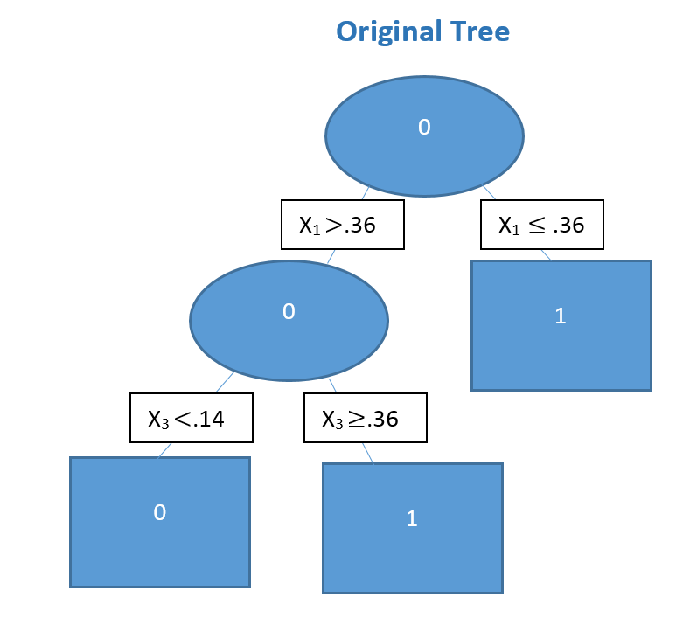
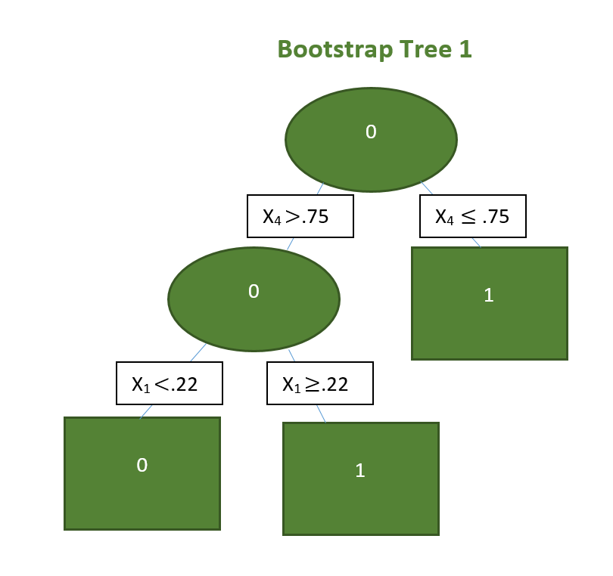
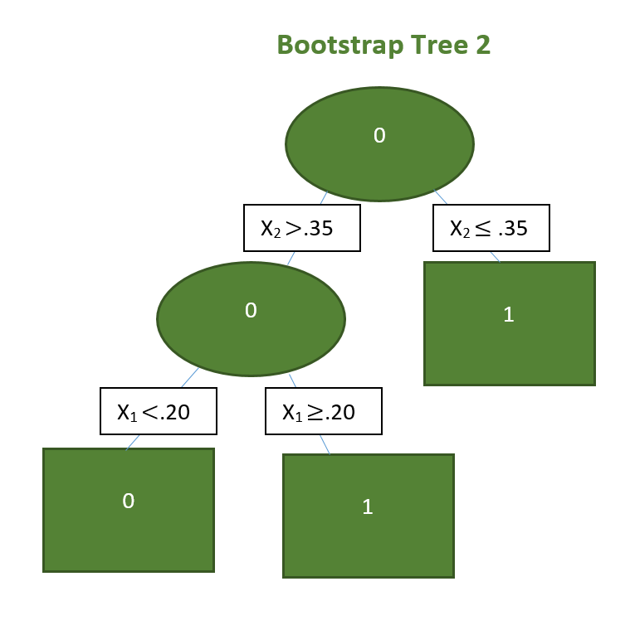
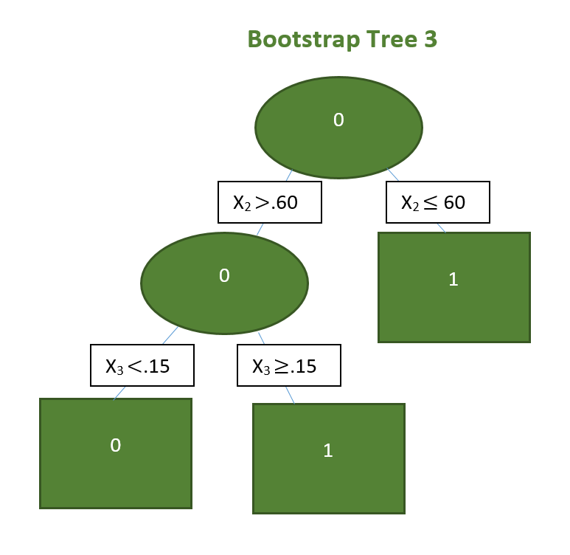
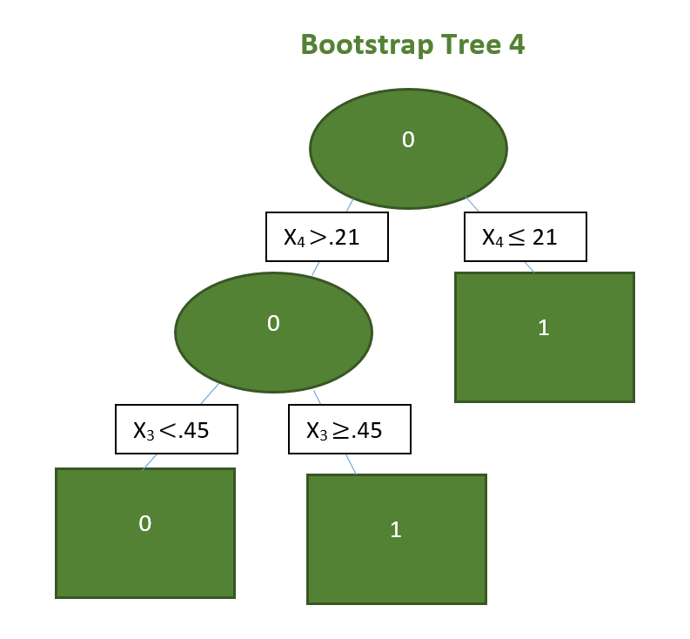
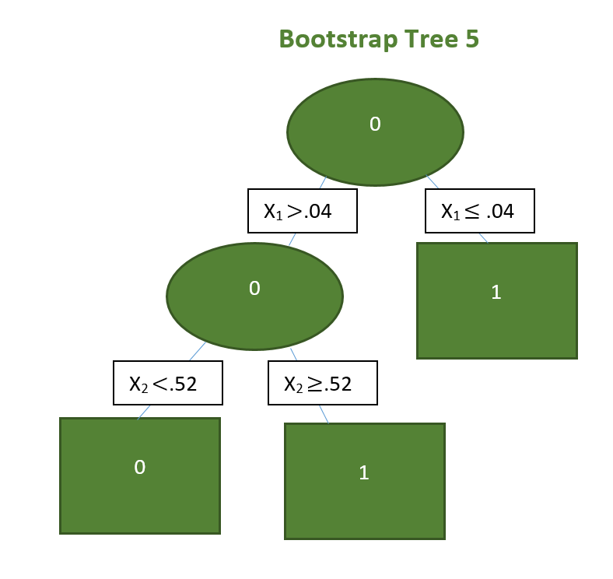
BAGGING DECISION TREES

Slide 30
PROS AND CONS OF BAGGING DECISION TREES
Advantages
Disadvantages
Reduces variance in comparison to regular decision trees
Can provide variable importance measures
Can easily handle qualitative (categorical) features
Out of bag (OOB) estimates can be used for model validation
Bagged models can be more difficult to interpret than single decision trees
When multiple predictors are used, it is not always clear which ones are important in a bagged model

Slide 31
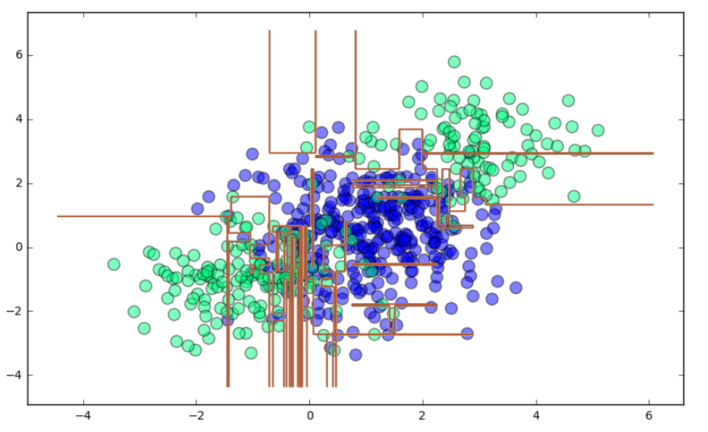
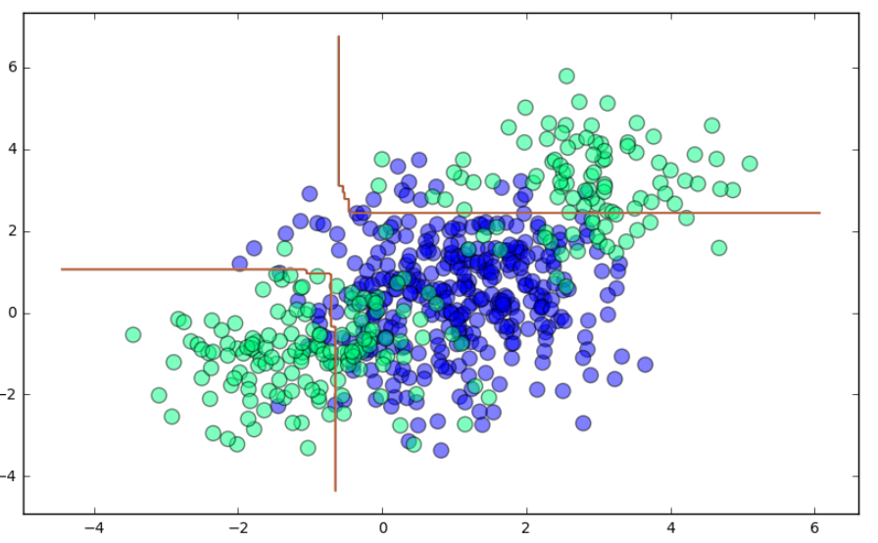
BAGGING DECISION TREES
Single Decision Tree Training Accuracy: 100%
Bagging Training Accuracy: 82.3%
Bagging Training Accuracy: 82.3%
We lose training accuracy with the bagging algorithm, but bagging generalizes to the data and may perform better on new observations than the single decision tree due to a smoother decision boundary.

Slide 32
INTRODUCTION
RANDOM FORESTS

Slide 33
BAGGING VS. RANDOM FORESTS
Suppose we have a set of m predictors. Further, suppose one of these predictors is a strong predictor for the outcome and many of the predictors are moderately strong
In a collection of bagged trees, most or all of the trees will use the strong predictor for the top split. As a result, the bagged trees will all be similar and their predictions will be correlated
Will averaging a number of highly correlated trees result in a significant reduction in variance over a single tree? Answer: NO.

Slide 34
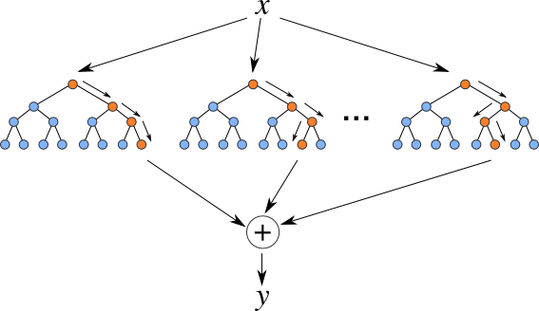
RUNNING THROUGH THE RANDOM FORESTS
Random forest models are one of the most widespread classifiers used because they are relatively simple to use and avoid overfitting.
They do this by ensembling or aggregating the results of several individual decision trees.

Slide 35
BOOTSTRAPPING
Random Sampling with replacement
Bootstrap Sample 1
Sample
With Replacement
Bootstrap Sample 2
With Replacement
Bootstrap Sample 3
With Replacement

Slide 36
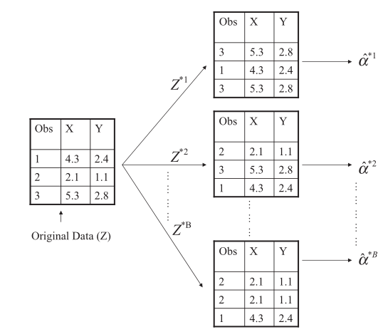
RUNNING THROUGH THE RANDOM FORESTS
Random forests generates many decision trees using another resampling method – bootstrapping.
Bootstrapping differs from cross-validation in two major ways - it creates large samples and allows replacement.

Slide 37
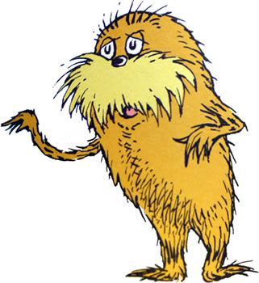
RUNNING THROUGH THE RANDOM FORESTS
For every bootstrapped sample, a decision tree is built and then the results are aggregated to form a random forest.
The idea is that individual trees are likely to overfit, but a set of trees generated from random samples of the original data are unlikely to overfit because each sample will be different.
Only the most significant decision rules will be the same
across different trees in the same forest.

Slide 38
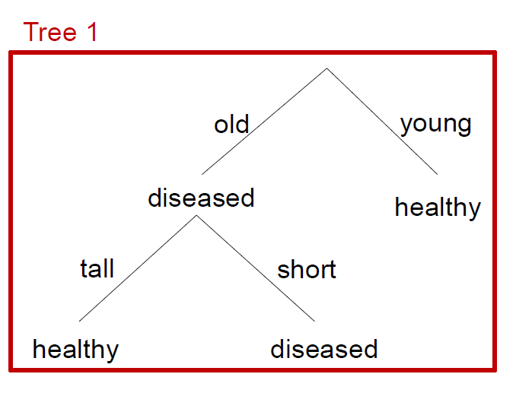
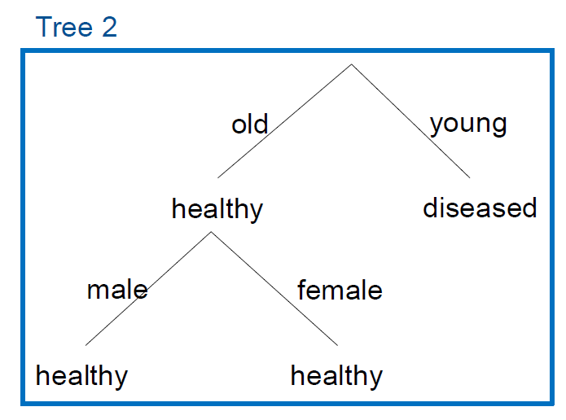
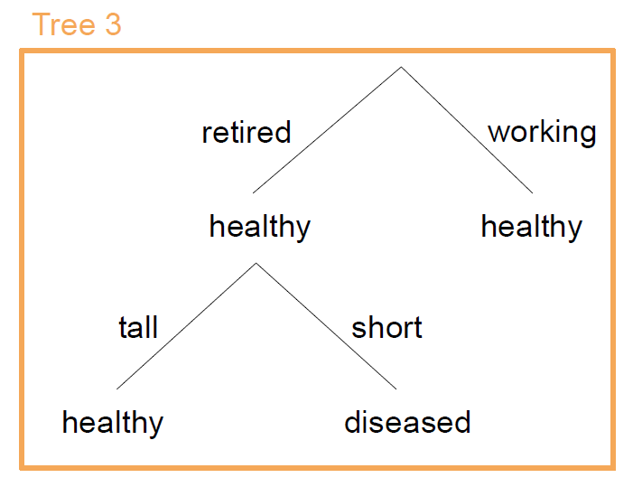
RANDOM FOREST: EXAMPLE
Inputs:
young, working, male, tall
Outputs:
healthy, diseased, healthy
Majority Vote:
Healthy

Slide 39


CONS OF RANDOM FORESTS
This comes with a major tradeoff – random forests are a black box model so we lose the interpretability and visualization of decision trees.
Even though random forests are a black box model, we still have access to all of the same tuning parameters as a regular decision tree plus one more – the number of trees to build before ensembling.

Slide 40
INTRODUCTION
BOOSTING

Slide 41
Bagging vs. Boosting

Slide 42
Bagging vs. Boosting

Slide 43
BOOSTING

Slide 44
SUMMARY

Slide 45
SUMMARY
Decision Trees
Bagging
Random Forest
Yield insight into decision rules
Computationally efficient/fast
Easy to tune parameters
High variance in predictions and overfitting
Easy to tune parameters
Smaller prediction variance (sometimes)
Difficult to interpret decision rules- often viewed as “black box”
May not reduce variance if features are correlated
Smaller prediction variance, even with correlated predictors
Easy to tune parameters
Difficult to interpret decision rules- often viewed as “black box”

Slide 46
INTRODUCTION
CITATIONS

Slide 47
CITATIONS
THANKS FOR THE FOLLOWING
Decision Tree Visualization: https://littleml.files.wordpress.com/2012/01/screen-shot-2012-01-23-at-10-00-17-am1.png
90's Flowchart, Munroe, Randall: https://xkcd.com/210/
Questions on some data-mining algorithms: https://stackoverflow.com/questions/4084668/questions-on-some-data-mining-algorithms

Slide 48
CITATIONS
THANKS FOR THE FOLLOWING
An Introduction to Statistical Learning, James, G et al (2013): http://www-bcf.usc.edu/~gareth/ISL/getbook.html
The Lorax (Character), Seuss Wikia: http://seuss.wikia.com/wiki/The_Lorax_(Character)
Classification and Regression Trees, Cosma Shalizi: http://www.stat.cmu.edu/~cshalizi/350/lectures/22/lecture-22.pdf

